Slide 1
Quality Refresher

Slide 2
Video:
Probing Questions.
Cable box images in KDB.
Tool Usage. (ITT, Cable Box Control, Outage Board, Channel Lineup).
Modify Services.

Slide 3
Probing Questions
The Probing Questions are a way to quickly identify customer’s issues. One of the first things that we need to ask the customer when they express an inconvenience is: Since when are they having the issue?. The next questions would be:
What do you see on your TV/Cable box screen?
Can you confirm that the box is properly connected to the power outlet and with the HDMI and Coaxial cable properly tight?.
Do you see any lights on the cable box?
Have you moved the cable box from one room to another?

Slide 4
Cable Box Images.
We have three types of cable boxes, these are:
The Altice One box.
The Samsung box.
The Scientific Atlanta.
Notes:
We can recognize the one that the customer has by going to DART in the ioBluePage tab and using the ITT tool as well. It’s shown as ‘’JCA’’ the Samsung, ‘’SC’’ the Scientific Atlanta and Altice One per its name. For more information or pictures about Optimum equipment, please refer to the Cable Box Images article in KDB.

Slide 5
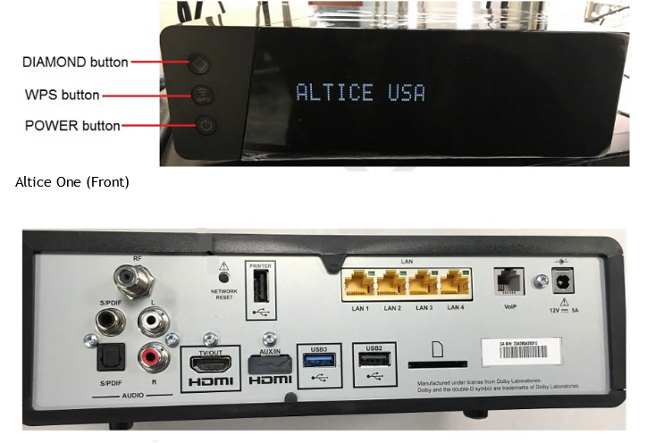
The Altice One (La Box)
As we can see the Altice One has many connections port. The only ones that we will be using are:
‘’RF’’ for coaxial wire.
‘’HDMI Tv/Out’’ For HDMI wire.
‘’The warning sign port’’ Power wire.
‘’VoIP port’’ for phone service.
‘’Yellow ports’’ for internet only.

Slide 6
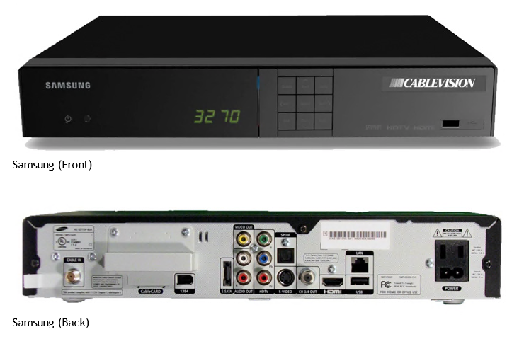
The Samsung Box
Coaxial wire in the ‘’Cable In’’ port.
Power wire in the ‘’Power’’ port.
‘’HDMI’’ For HDMI wire.
Notes:
Keep in mind that we need to confirm if the customer has components wires instead of HDMI.

Slide 7
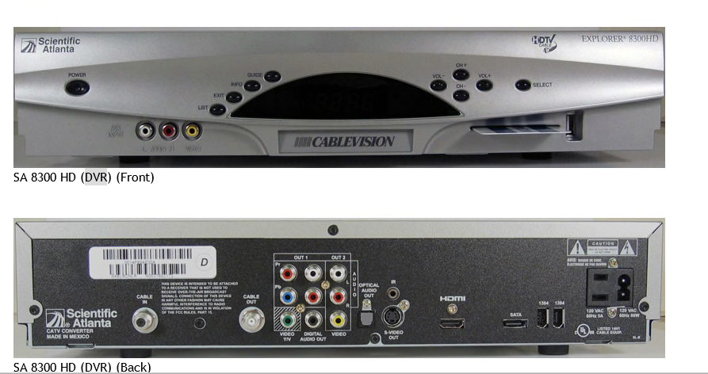
Scientific Atlanta
Coaxial wire in the ‘’Cable In’’ port.
Power wire in the ‘’Power’’ port.
Components wires in the ‘’Out 1’’ ports.
Notes:
This is the Scientific Atlanta Model 8300, please refer to Cable Box Images article in KDB for more models and images.

Slide 8
Tool Usage
To provide the best resolution we must follow all our troubleshooting tools, such as:
Intelligent Troubleshooting Tool (ITT).
Cable Box Control.
OutageBoard.
Channel Lineup.
The tools will help us to quickly identify customer’s issues and provide a resolution as it brings reliable troubleshooting steps.

Slide 9
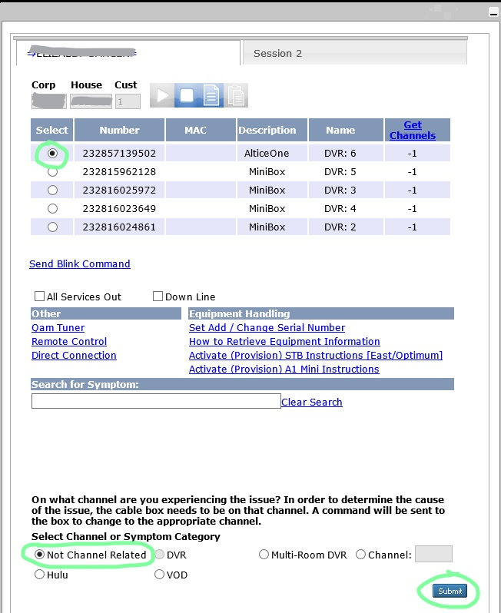
Intelligent Troubleshooting Tool (ITT)
While using the tool make sure you have the customer’s account in Dart and choose the option according to the issue explained by the customer.
Please keep in mind that we need to select the box that is having issues and after that choose ‘’Not Channel Related’’ even if the issue is with a channel then click ‘’Submit’’.

Slide 10
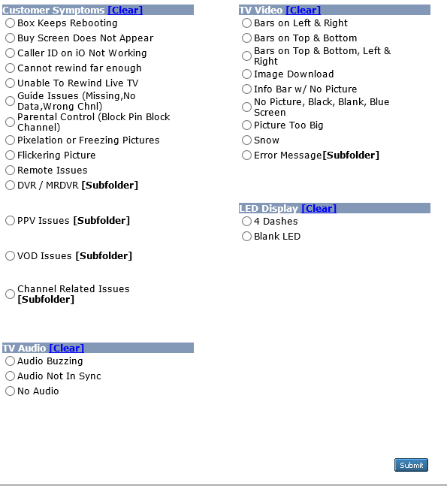
In this image we can find the different options for the types of errors or issues the customer could have with the cable box, channels, audio, remote control and more.

Slide 11
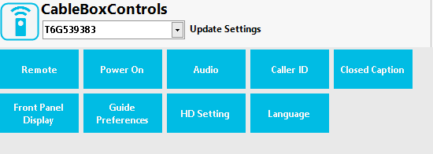
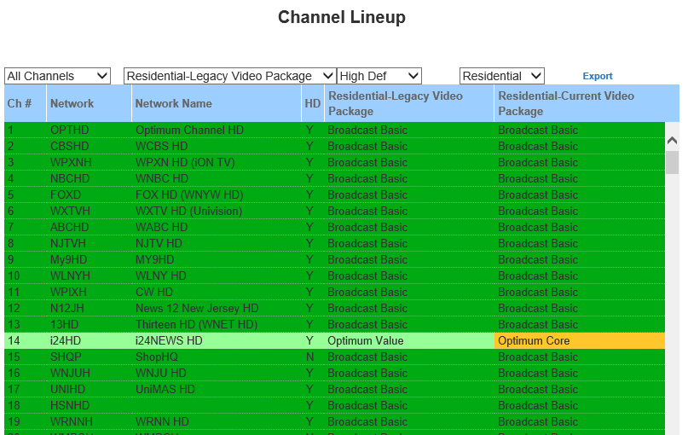
The Cable box control will help us to change channels, turn Off /On the box, reboot it, and more. (This Widget works with Samsung and Scientific Atlanta boxes only). Not Compatible with the Altice One
We use the Channel Lineup to identify if the channel that is having issues is within the package that the customer has.

Slide 12
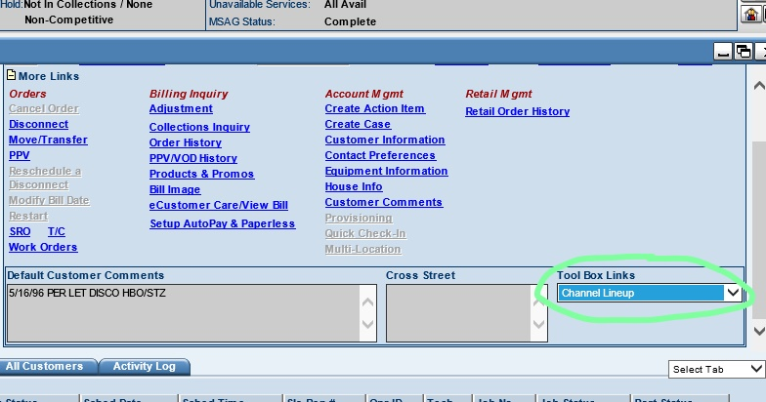
Where do we find the Channel Lineup?

Slide 13
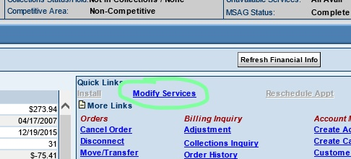
Modify Services
When a customer request a downgrade, upgrade, add or remove DVR service we need to go to ‘’Modify Services’’ after doing our CPNI Security Process to complete any change on the account. Keep in mind, that we can also confirm customer’s services in this tab.
We will find the Monthly Rate without taxes within Modify Services, it’s located in the ‘’Recurring Charges’’ in the left side.
Notes:
When the customer is expressing an issue with any channel, we can go first the Channel Lineup and confirm which package brings the channel and then go to ‘’Modify Services’’ to confirm if the customer has the package to be able to watch the channel. If they have it and is presenting issues, please Run ITT.

Slide 14
